Slide 1
Chapter 1
Introduction to Compilers

Slide 2
Compilers and Interpreters
“Compilation”
  Translation of a program written in a source language into a semantically equivalent program written in a target language
  Oversimplified view:
Input
Source
Program
Compiler
Target
Program
Error messages
Output

Slide 3
Compilers and Interpreters (cont’d)
“Interpretation”
  Performing the operations implied by the source program
  Oversimplified view:
Source
Program
Interpreter
Output
Input
Error messages

Slide 4
Compilers and Interpreters (cont’d)
Compiler: a program that translates an executable program in one language into an executable program in another language
Interpreter: a program that reads an executable program and produces the results of running that program

Slide 5
The Analysis-Synthesis Model of Compilation
There are two parts to compilation:
  Analysis
    Breaks up source program into pieces and imposes a grammatical structure
    Creates intermediate representation of source program
    Determines the operations and records them in a tree structure, syntax tree
    Known as front end of compiler

Slide 6
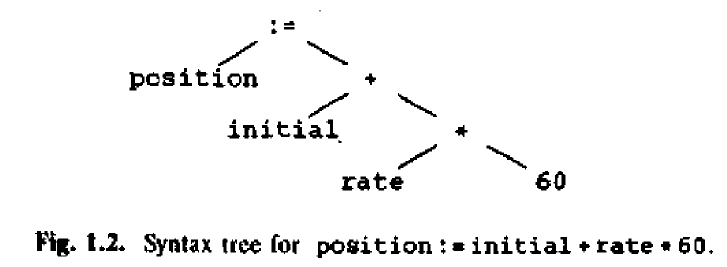
The Analysis-Synthesis Model of Compilation (cont’d)
  Synthesis
    Constructs target program from intermediate representation
    Takes the tree structure and translates the operations into the target program
    Known as back end of compiler

Slide 7
Other Tools that Use the Analysis-Synthesis Model
Editors (syntax highlighting)
Pretty printers (e.g. Doxygen)
Static checkers (e.g. Lint and Splint)
Interpreters
Text formatters (e.g. TeX and LaTeX)
Silicon compilers (e.g. VHDL)
Query interpreters/compilers (Databases)

Slide 8
A language-processing system
Skeletal Source Program
Preprocessor
Source Program
Try for example:
gcc -v myprog.c
Compiler
Target Assembly Program
Assembler
Relocatable Object Code
Linker
Libraries and
Relocatable Object Files
Absolute Machine Code

Slide 9
Analysis
In compiling, analysis has three phases:
  Linear analysis: stream of characters read from left-to-right and grouped into tokens; known as lexical analysis or scanning
  Hierarchical analysis: tokens grouped hierarchically with collective meaning; known as parsing or syntax analysis
  Semantic analysis: check if the program components fit together meaningfully

Slide 10
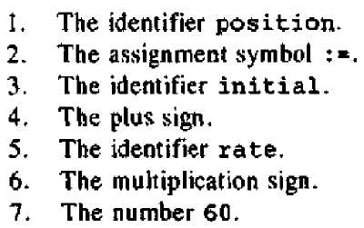
Lexical analysis
Characters grouped into tokens.

Slide 11
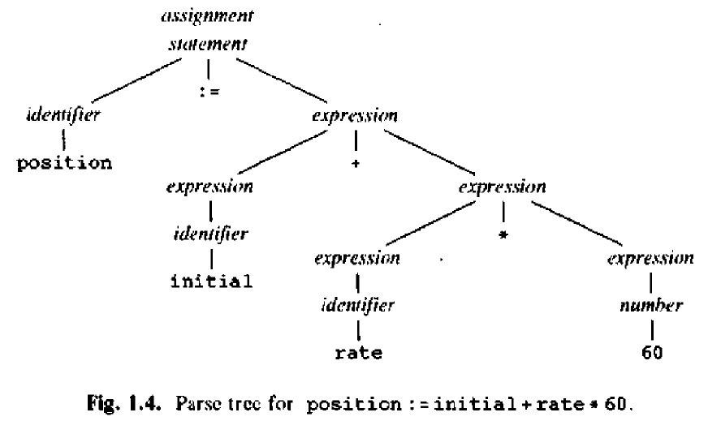
Syntax analysis (Parsing)
Grouping tokens into grammatical phrases
Character groups recorded in symbol table
Represented by a parse tree

Slide 12
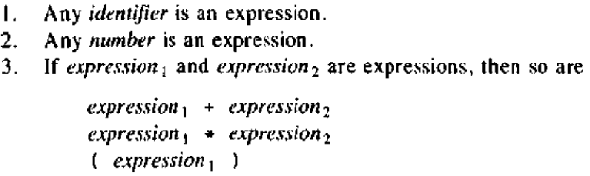
Syntax analysis (cont’d)
Hierarchical structure usually expressed by recursive rules
Rules for definition of expression:

Slide 13
Semantic analysis
Checks source program for semantic errors
Gathers type information for subsequent code generation (type checking)
Identifies operator and operands of expressions and statements

Slide 14
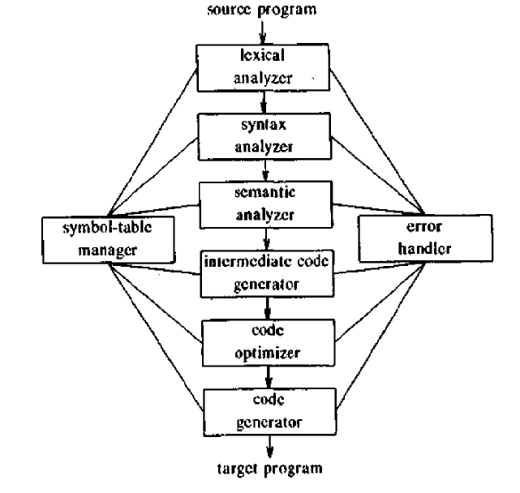
Phases of a compiler

Slide 15
Symbol-Table Management
Symbol table – data structure with a record for each identifier and its attributes
Attributes include storage allocation, type, scope, etc
All the compiler phases insert and modify the symbol table

Slide 16
Intermediate code generation
Program representation for an abstract machine
Should have two properties
  Easy to produce
  Easy to translate into target program
Three-address code is a commonly used form – similar to assembly language

Slide 17
Code optimization and generation
Code Optimization
  Improve intermediate code by producing code that runs faster
Code Generation
  Generate target code, which is machine code or assembly code

Slide 18
The Phases of a Compiler
Phase | Output | Sample
Programmer (source code producer) | Source string | A=B+C;
Scanner (performs lexical analysis) | Token string | ‘A’, ‘=’, ‘B’, ‘+’, ‘C’, ‘;’ And symbol table with names
Parser (performs syntax analysis based on the grammar of the programming language) | Parse tree or abstract syntax tree | ; | = / \ A + / \ B C
Semantic analyzer (type checking, etc) | Annotated parse tree or abstract syntax tree
Intermediate code generator | Three-address code, quads, or RTL | int2fp B t1 + t1 C t2 := t2 A
Optimizer | Three-address code, quads, or RTL | int2fp B t1 + t1 #2.3 A
Code generator | Assembly code | MOVF #2.3,r1 ADDF2 r1,r2 MOVF r2,A

Slide 19
The Grouping of Phases
Compiler front and back ends:
  Front end:
    Analysis steps + Intermediate code generation
    Depends primarily on the source language
    Machine independent
  Back end:
    Code optimization and generation
    Independent of source language
    Machine dependent

Slide 20
The Grouping of Phases (cont’d)
Compiler passes:
  A collection of phases is done only once (single pass) or multiple times (multi pass)
    Single pass: reading input, processing, and producing output by one large compiler program; usually runs faster
    Multi pass: compiler split into smaller programs, each making a pass over the source; performs better code optimization

Slide 21
Compiler-Construction Tools
Software development tools are available to implement one or more compiler phases
  Scanner generators
  Parser generators
  Syntax-directed translation engines
  Automatic code generators
  Data-flow engines

